Slide 1
Byte Engine
- Oh Country? Just search here!

Slide 2
Meet our Team
Sai Tharun Reddy Garlapati
Hitesh Atluri
Monisha Ramu
Dhruvi Sonani
Kruti Marvania
Sravya Mareedu
Tathya Thaker
Parth Sabhadiya
Scraping Team
Front End Team
Backend Team

Slide 3
Introduction
This Project deals with the design and implementation of a powerful and feature-rich tool that optimizes our use case using a crawler-based search engine.
There are many general-purpose search engines. Hence, we took a particular domain – countries.
The aim of this project work is to create a web-based search engine that yields quick and precise search results to any input related to the countries of the world in a user-friendly environment.

Slide 4
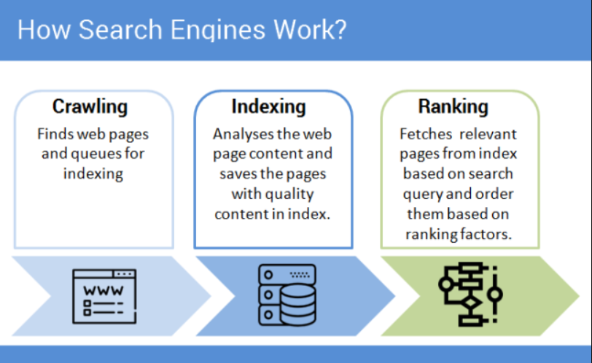





Components

Slide 5
Functional Requirements
Comparing Results
The results of Byte Engine is compared with that of Google and Microsoft.
Ordering of Results
The results must be ranked in the order of occurrence.
Filter Stop Words
The search engine should be able filter stop words like ’and’ , ’or’ to concentrate on key words.
Auto-fill Support
The search engine should give suggestions using cache.
Concurrent Operation
The search engine should be able to perform parallel processing.
No. of Results per Page
The search results should show certain number of results per page.

Slide 6
Non – Functional Requirements
User-Friendly The search engine should be user friendly.
Responsive
with low latency - The search engine should give the results within a few milliseconds.
Scalable
Reusable
with good performance.
Adaptive
Search Engine should be able to adapt any new changes in the system without affecting any other functionalities.
Portable
Search Engine should
be able to run on any system.
Concurrency
More than one user should be able to access the search engine simultaneously.

Slide 7
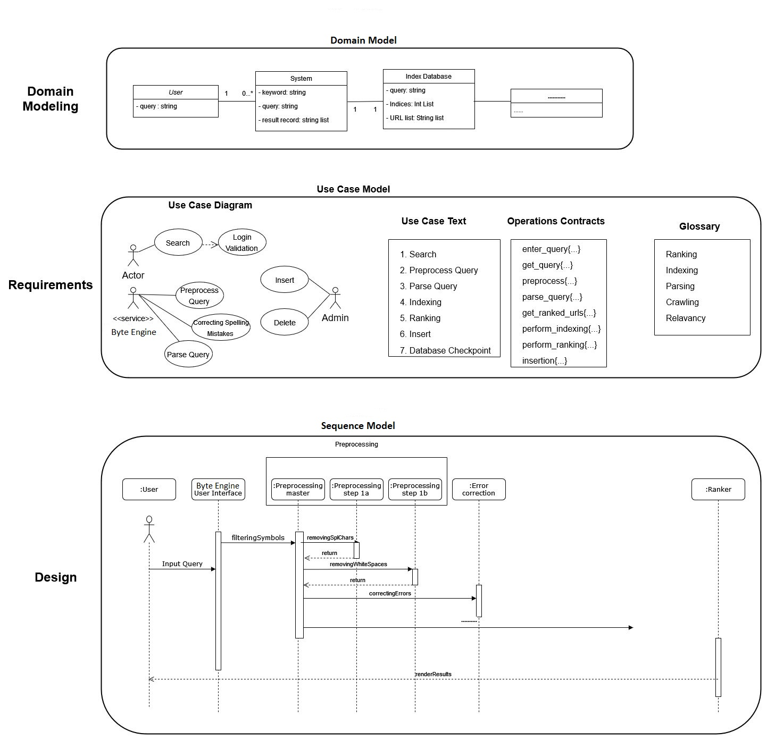
Big Picture

Slide 8
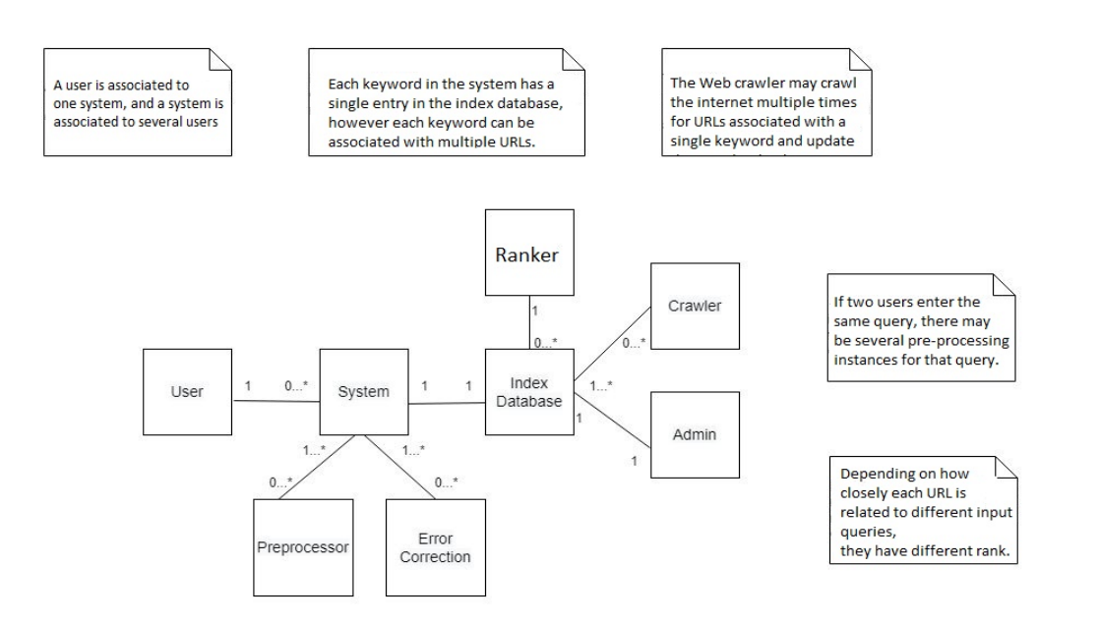
Domain Model

Slide 9
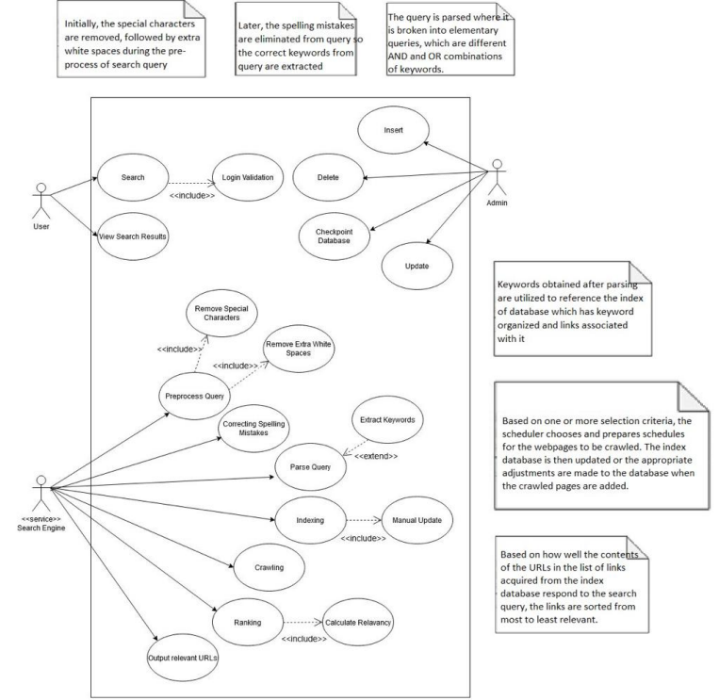
Use Case Diagram

Slide 10
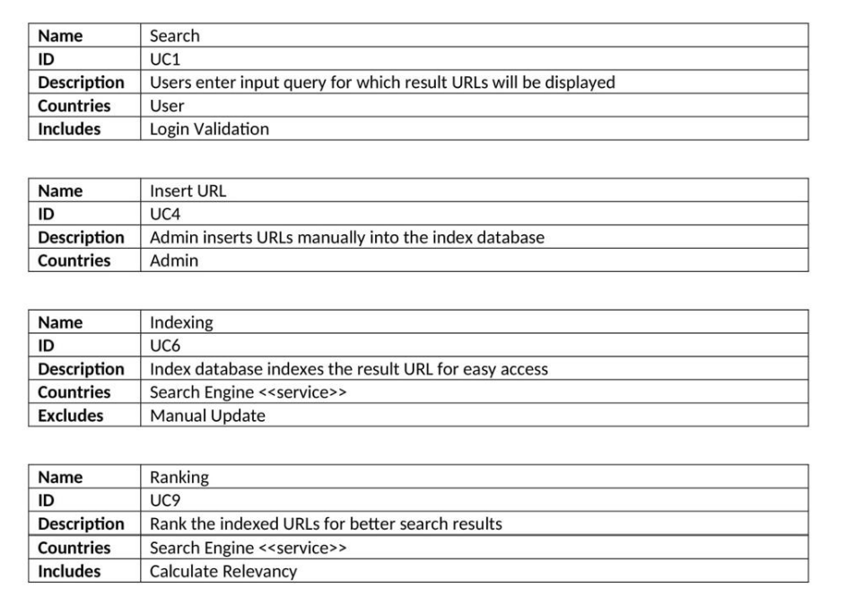
Use case Template

Slide 11
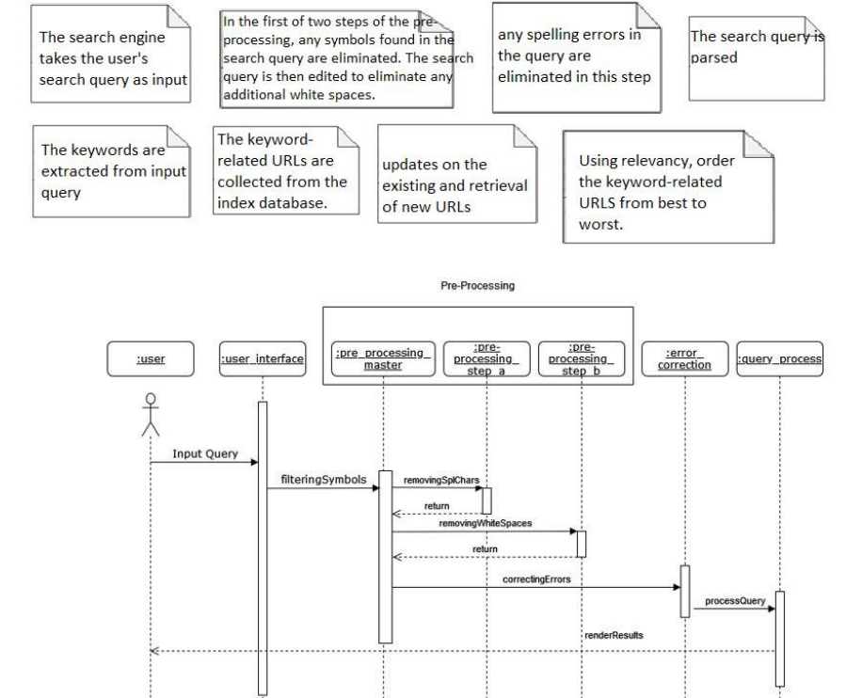
Sequence Diagram for Preprocessing

Slide 12
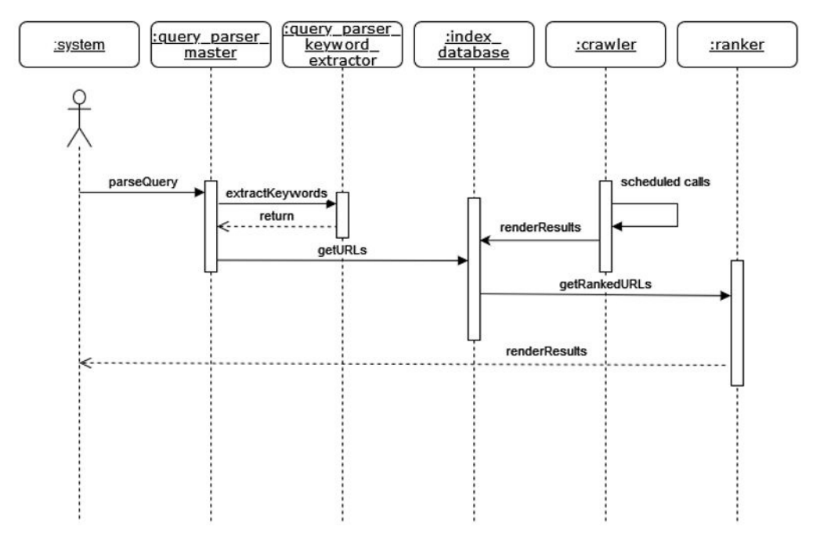
Sequence Diagram (search engine core)

Slide 13
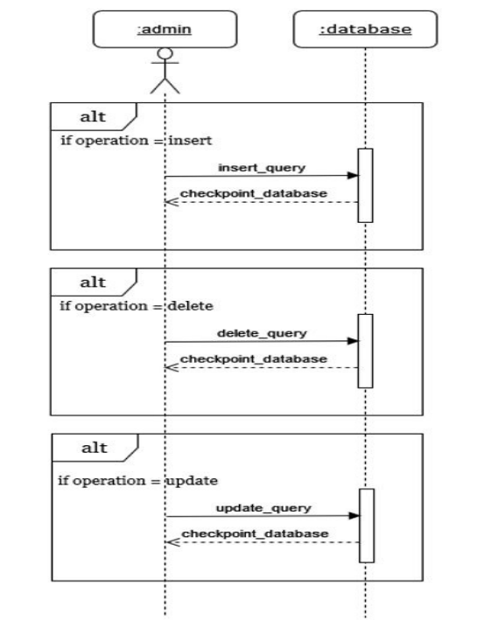
Sequence Diagram (Admin)

Slide 14
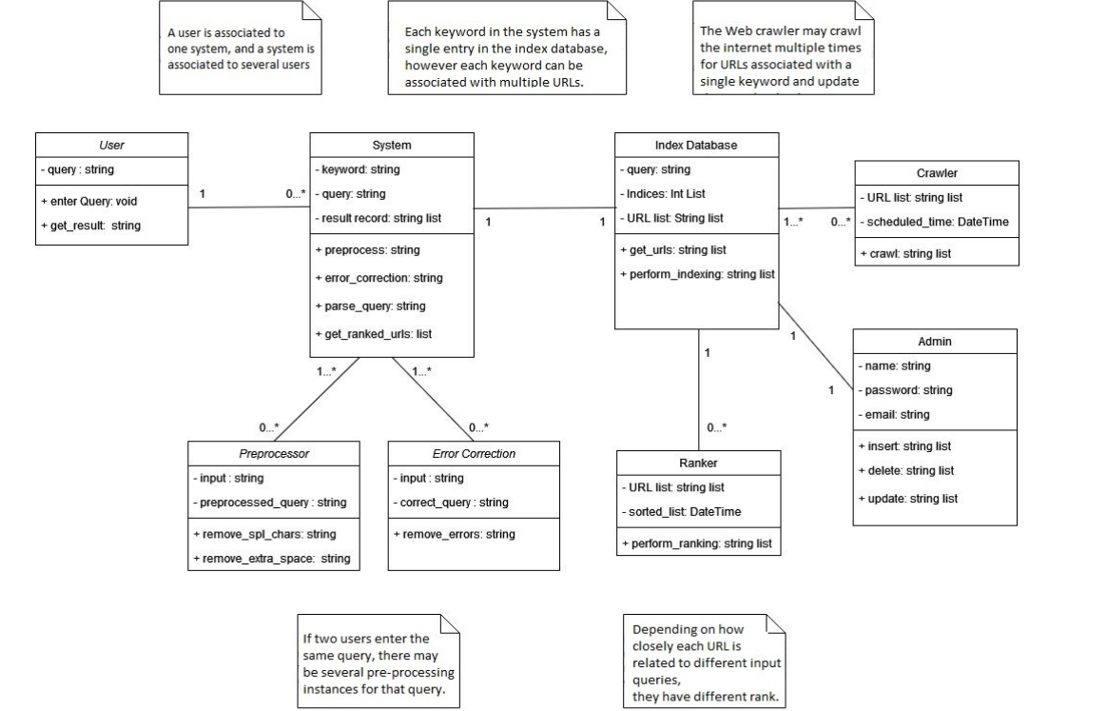
Class Diagram

Slide 15
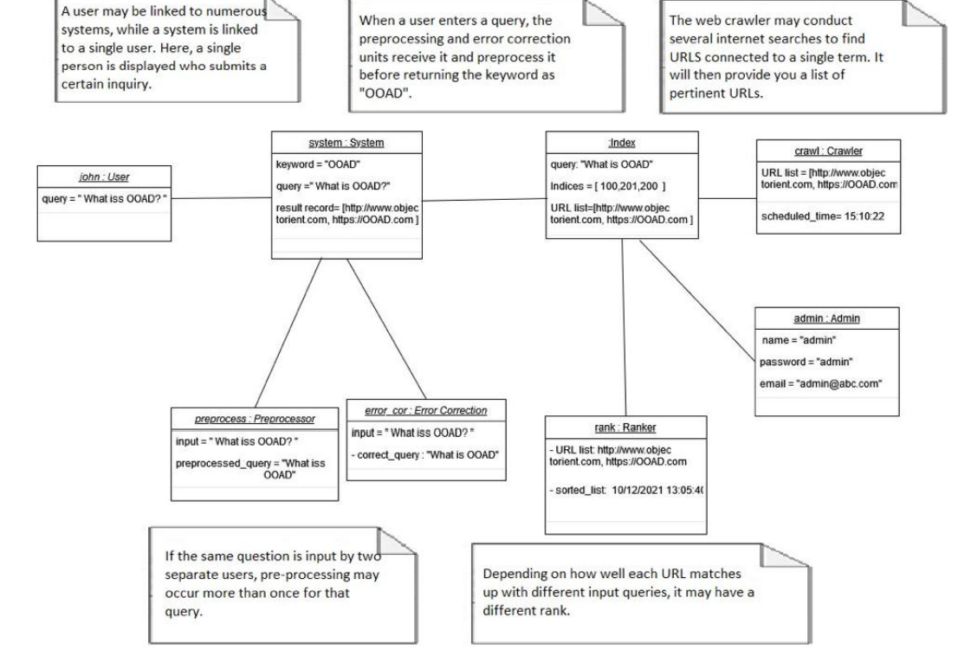
Object Diagram

Slide 16
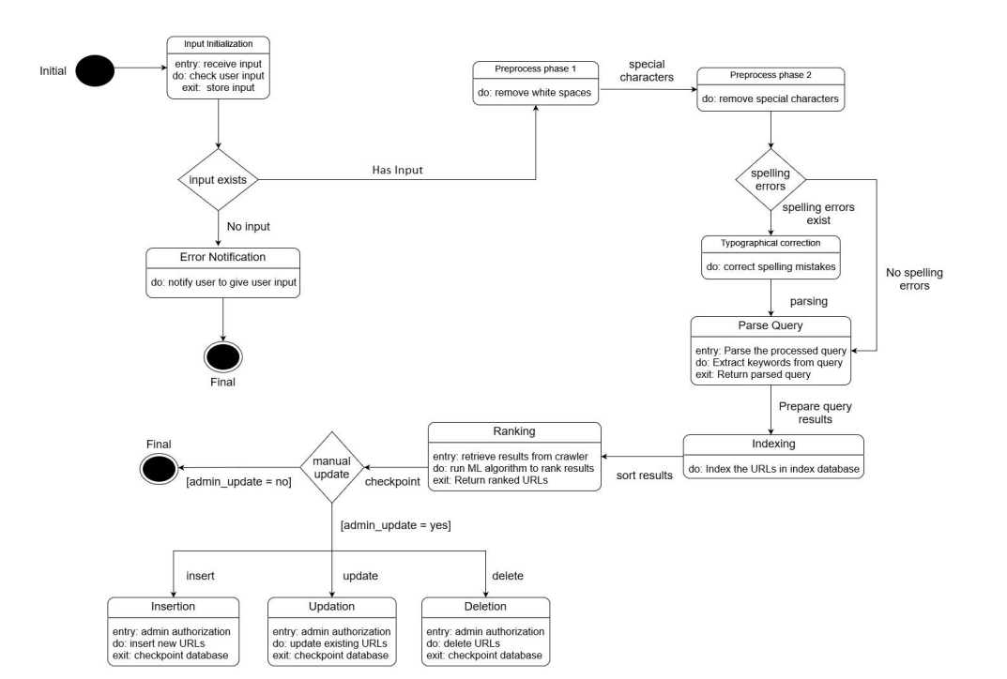
State Transition Diagram

Slide 17
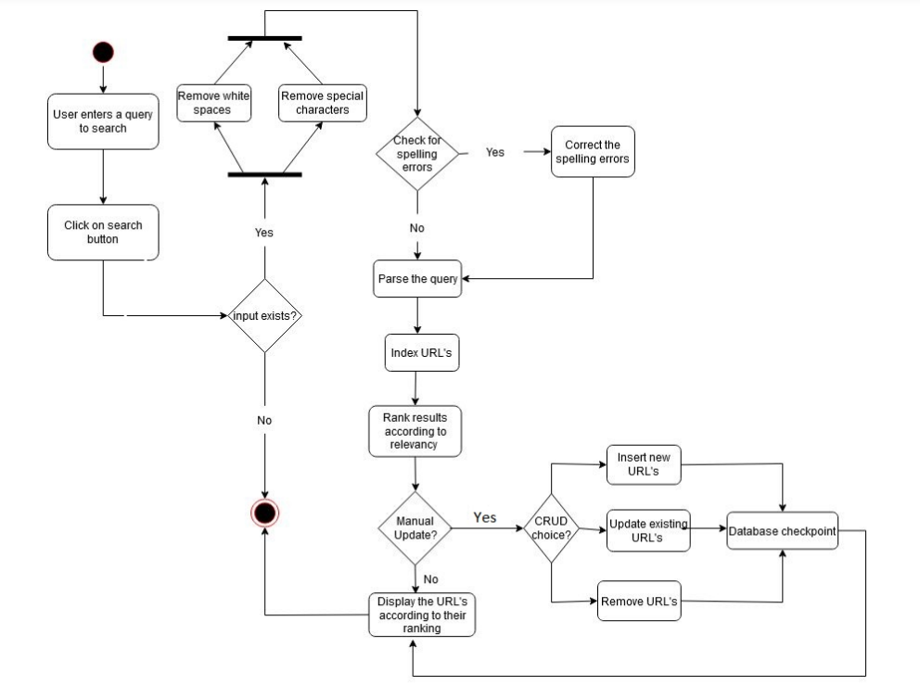
Activity Diagram

Slide 18
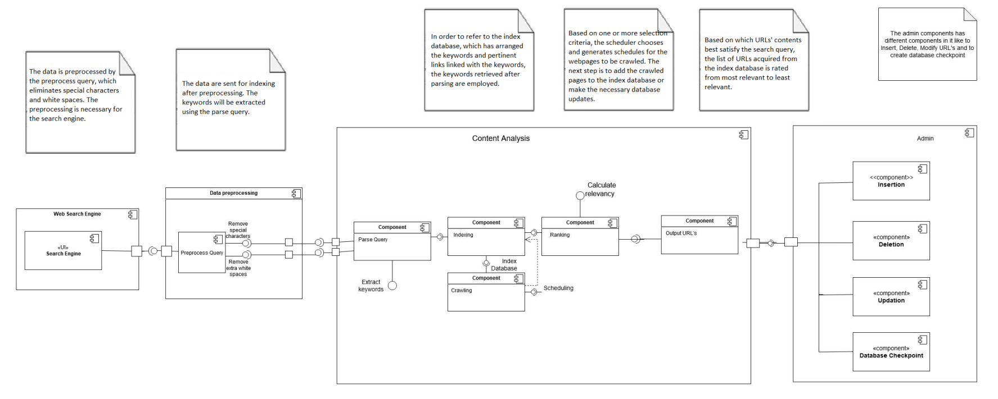
Component Diagram

Slide 19
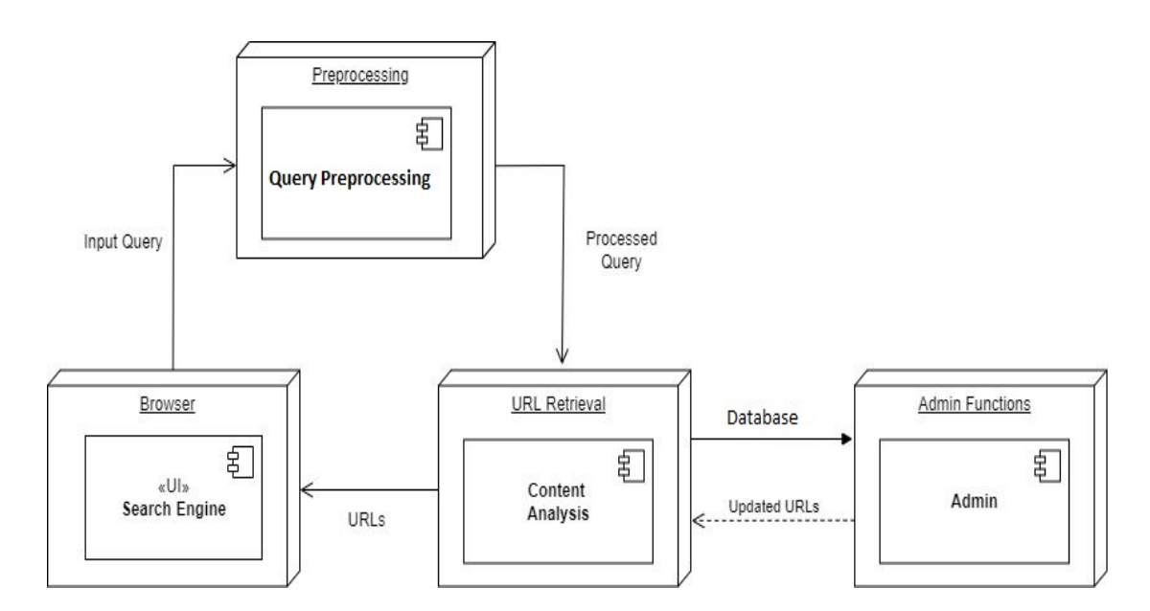
Deployment diagram

Slide 20
Test Cases
Entering Valid Input and checking the returned result URLs.
Entering no input and trying to search.
Input having typographical mistakes.
Validating ranked URLs.
Checking Indexing Methodology in Database.
Having white spaces and special characters in the input.

Slide 21
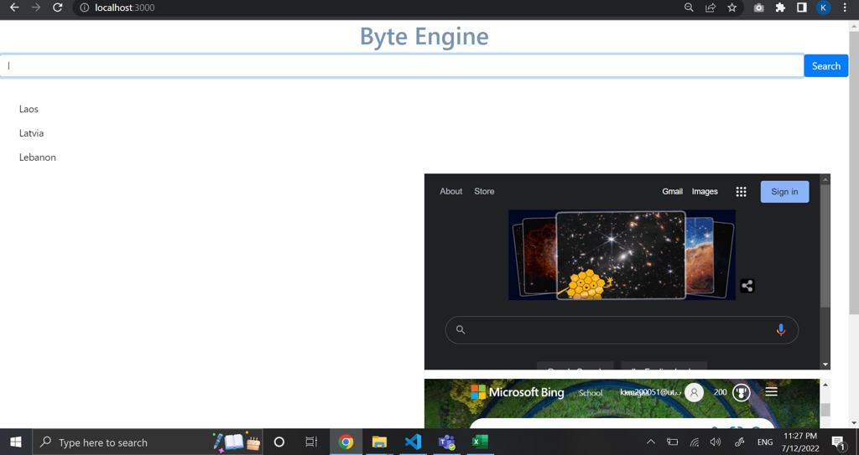

Slide 22
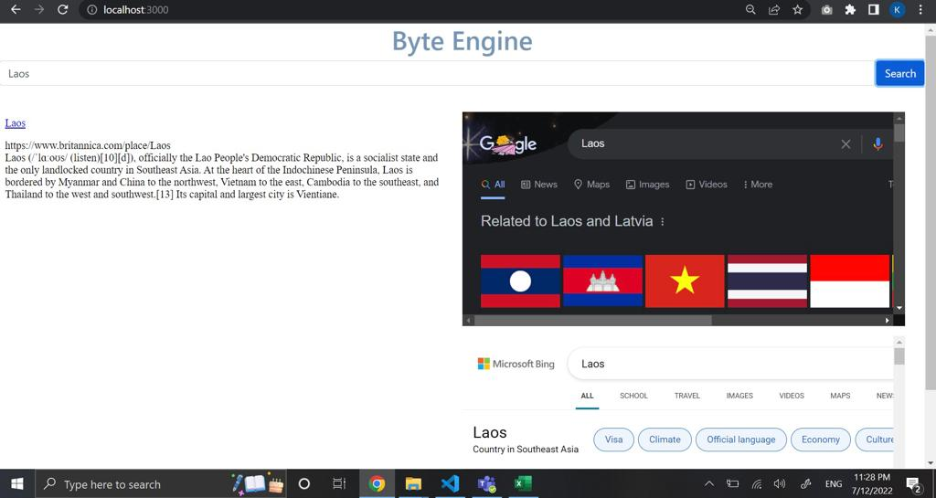

Slide 23
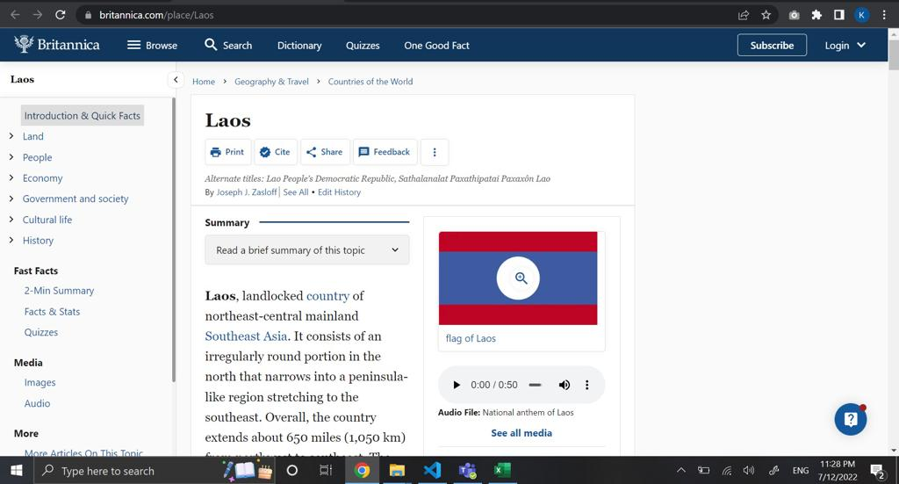

Slide 24
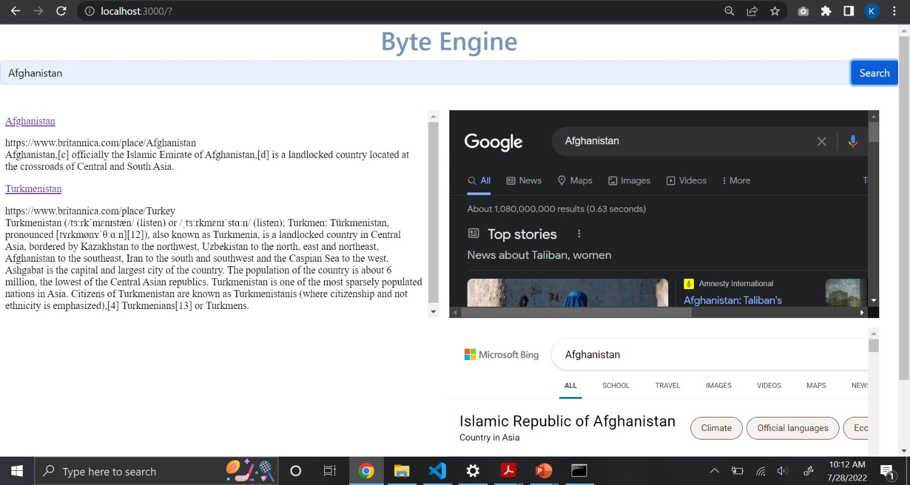

Slide 25
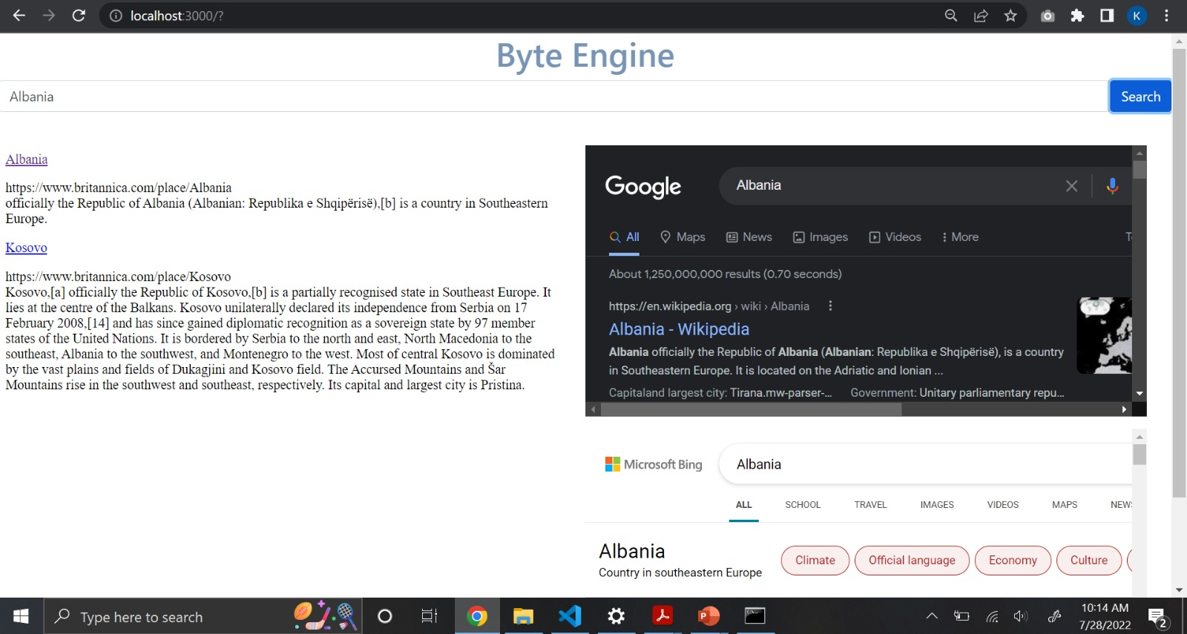

Slide 26
Conclusion
We used UML diagrams to represent the project and choose the next actions to take.
We also compared the search results with Google and Microsoft search engines.
Use case, Sequence, State transition, and Activity diagrams helped us grasp the system’s dynamic features, while Class, Object, Component, and Deployment diagrams helped us understand the system’s static aspects.
In addition to offering information, search engines assist businesses in promoting their websites.
A search engine gives us knowledge in a split second in this age of expanding information, something we couldn’t have believed was feasible just a few decades ago. Every day, it gains more powers

Slide 27
Thank You

